Slide 1
Planning

Slide 2
Planning Agent
sensors
?
environment
agent
actuators
A1
A2
A3

Slide 3
Outline
The Planning problem
Planning with State-space search
Partial-order planning
Hierarchical Planning

Slide 4
Planning problem
Classical planning environment: fully observable, deterministic, finite, static and discrete.
Find a sequence of actions that achieves a given goal when executed from a given initial world state. That is, given
  a set of action descriptions (defining the possible primitive actions by the agent),
  an initial state description, and
  a goal state description or predicate,
compute a plan, which is
  a sequence of action instances, such that executing them in the initial state will change the world to a state satisfying the goal-state description.
Goals are usually specified as a conjunction of subgoals to be achieved

Slide 5
Planning vs. problem solving
Planning and problem solving methods can often solve the same sorts of problems
Planning is more powerful because of the representations and methods used
States, goals, and actions are decomposed into sets of sentences (usually in first-order logic)
Search often proceeds through plan space rather than state space (though first we will talk about state-space planners)
Subgoals can be planned independently, reducing the complexity of the planning problem

Slide 6
Goal of Planning
Choose actions to achieve a certain goal
But isn’t it exactly the same goal as for problem solving?
Some difficulties with problem solving:
  The successor function is a black box: it must be “applied” to a state to know which actions are possible in that state and what are the effects of each one
Suppose that the goal is HAVE(MILK).
From some initial state where HAVE(MILK) is not
satisfied, the successor function must be repeatedly
applied to eventually generate a state where
HAVE(MILK) is satisfied.
An explicit representation of the possible actions
and their effects would help the problem solver
select the relevant actions
Otherwise, in the real world an agent would
be overwhelmed by irrelevant actions

Slide 7
Goal of Planning
Choose actions to achieve a certain goal
But isn’t it exactly the same goal as for problem solving?
Some difficulties with problem solving:
  The goal test is another black-box function, states are domain-specific data structures, and heuristics must be supplied for each new problem
Suppose that the goal is HAVE(MILK)∧HAVE(BOOK)
Without an explicit representation of the goal, the
problem solver cannot know that a state where
HAVE(MILK) is already achieved is more promising
than a state where neither HAVE(MILK) nor
HAVE(BOOK) is achieved

Slide 8
Goal of Planning
Choose actions to achieve a certain goal
But isn’t it exactly the same goal as for problem solving?
Some difficulties with problem solving:
  The goal may consist of several nearly independent subgoals, but there is no way for the problem solver to know it
HAVE(MILK) and HAVE(BOOK) may be achieved by
two nearly independent sequences of actions

Slide 9
Representations in Planning
Planning opens up the black-boxes by using logic to represent:
  Actions
  States
  Goals
Problem solving
Logic representation
Planning

Slide 10
Planning language
What is a good language?
  Expressive enough to describe a wide variety of problems.
  Restrictive enough to allow efficient algorithms to operate on it.
  Planning algorithm should be able to take advantage of the logical structure of the problem.
STRIPS and ADL

Slide 11
General language features
Representation of states
  Decompose the world in logical conditions and represent a state as a conjunction of positive literals.
    Propositional literals: Poor ∧ Unknown
    FO-literals (grounded and function-free): At(Plane1, Melbourne) ∧ At(Plane2, Sydney)
Representation of goals
  Partially specified state and represented as a conjunction of positive ground literals
  A goal is satisfied if the state contains all literals in goal.

Slide 12
General language features
Representations of actions
  Action = PRECOND + EFFECT
    Action(Fly(p,from, to),
    PRECOND: At(p,from) ∧ Plane(p) ∧ Airport(from) ∧ Airport(to)
    EFFECT: ¬AT(p,from) ∧ At(p,to))
  = action schema (p, from, to need to be instantiated)
    Action name and parameter list
    Precondition (conj. of function-free literals)
    Effect (conj of function-free literals and P is True and not P is false)
  Add-list vs delete-list in Effect

Slide 13
Language semantics?
How do actions affect states?
  An action is applicable in any state that satisfies the precondition.
  For FO action schema applicability involves a substitution θ for the variables in the PRECOND.
    At(P1,JFK) ∧ At(P2,SFO) ∧ Plane(P1) ∧ Plane(P2) ∧ Airport(JFK) ∧ Airport(SFO)
    Satisfies : At(p,from) ∧ Plane(p) ∧ Airport(from) ∧ Airport(to)
    With θ ={p/P1,from/JFK,to/SFO}
    Thus the action is applicable.

Slide 14
Language semantics?
The result of executing action a in state s is the state s’
  s’ is same as s except
    Any positive literal P in the effect of a is added to s’
    Any negative literal ¬P is removed from s’
    EFFECT: ¬AT(p,from) ∧ At(p,to):
    At(P1,SFO) ∧ At(P2,SFO) ∧ Plane(P1) ∧ Plane(P2) ∧ Airport(JFK) ∧ Airport(SFO)
  STRIPS("STanford Research Institute Problem Solver)
  assumption: (avoids representational frame problem)
    every literal NOT in the effect remains unchanged

Slide 15
Expressiveness and extensions
STRIPS is simplified
  Important limit: function-free literals
    Allows for propositional representation
    Function symbols lead to infinitely many states and actions
Recent extension:Action Description language (ADL)
    Action(Fly(p:Plane, from: Airport, to: Airport),
    PRECOND: At(p,from) ∧ (from ≠ to)
    EFFECT: ¬At(p,from) ∧ At(p,to))
Standardization : Planning domain definition language (PDDL)

Slide 16
Planning with state-space search
Both forward and backward search possible
Progression planners
  forward state-space search
  Consider the effect of all possible actions in a given state
Regression planners
  backward state-space search
  To achieve a goal, what must have been true in the previous state.

Slide 17
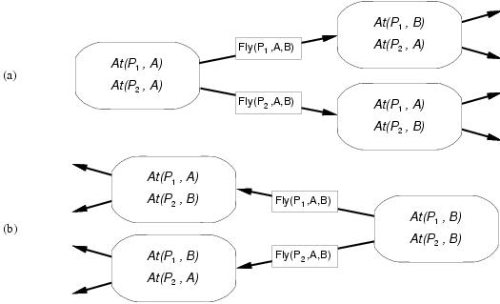
Progression and regression

Slide 18
Progression algorithm
Formulation as state-space search problem:
  Initial state = initial state of the planning problem
    Literals not appearing are false
  Actions = those whose preconditions are satisfied
    Add positive effects, delete negative
  Goal test = does the state satisfy the goal
  Step cost = each action costs 1
Inefficient:
  (1) irrelevant action problem
  (2) good heuristic required for efficient search

Slide 19
Regression algorithm
How to determine predecessors?
  What are the states from which applying a given action leads to the goal?
    Goal state = At(C1, B) ∧ At(C2, B) ∧ … ∧ At(C20, B)
    Relevant action for first conjunct: Unload(C1,p,B)
    Works only if pre-conditions are satisfied.
    Previous state= In(C1, p) ∧ At(p, B) ∧ At(C2, B) ∧ … ∧ At(C20, B)
    Subgoal At(C1,B) should not be present in this state.
Actions must not undo desired literals (consistent)
Main advantage: only relevant actions are considered.
  Often much lower branching factor than forward search.

Slide 20
Regression algorithm
General process for predecessor construction
  Give a goal description G
  Let A be an action that is relevant and consistent
  The predecessors is as follows:
    Any positive effects of A that appear in G are deleted.
    Each precondition literal of A is added , unless it already appears.
Any standard search algorithm can be added to perform the search.
Termination when predecessor satisfied by initial state.
  In FO case, satisfaction might require a substitution.

Slide 21
Heuristics for state-space search
Neither progression or regression are very efficient without a good heuristic.
  How many actions are needed to achieve the goal?
  Exact solution is NP hard, find a good estimate
Two approaches to find admissible heuristic:
  The optimal solution to the relaxed problem.
    Remove all preconditions from actions
  The subgoal independence assumption:
    The cost of solving a conjunction of subgoals is approximated by the sum of the costs of solving the subproblems independently.

Slide 22
Partial-order planning
Progression and regression planning are totally ordered plan search forms.
  They cannot take advantage of problem decomposition.
    Decisions must be made on how to sequence actions on all the subproblems
Least commitment strategy:
  Delay choice during search

Slide 23
Shoe example
Goal(RightShoeOn ∧ LeftShoeOn)
Init()
Action(RightShoe, PRECOND: RightSockOn
EFFECT: RightShoeOn)
Action(RightSock, PRECOND:
EFFECT: RightSockOn)
Action(LeftShoe, PRECOND: LeftSockOn
EFFECT: LeftShoeOn)
Action(LeftSock, PRECOND:
EFFECT: LeftSockOn)
Planner: combine two action sequences (1)leftsock, leftshoe (2)rightsock, rightshoe

Slide 24
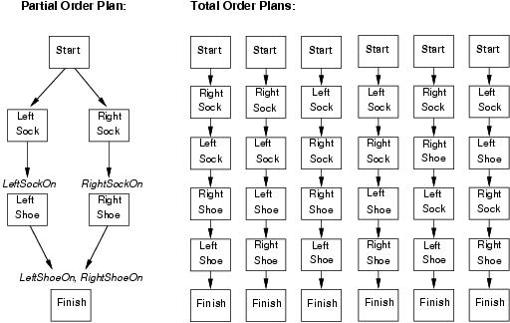
Partial-order planning(POP)
Any planning algorithm that can place two actions into a plan without which comes first is a PO plan.

Slide 25

POP as a search problem
States are (mostly unfinished) plans.
  The empty plan contains only start and finish actions.
Each plan has 4 components:
  A set of actions (steps of the plan)
  A set of ordering constraints: A < B (A before B)
    Cycles represent contradictions.
  A set of causal links
    The plan may not be extended by adding a new action C that conflicts with the causal link. (if the effect of C is ¬p and if C could come after A and before B)
  A set of open preconditions.
    If precondition is not achieved by action in the plan.

Slide 26
Example of final plan
Actions={Rightsock, Rightshoe, Leftsock, Leftshoe, Start, Finish}
Orderings={Rightsock < Rightshoe; Leftsock < Leftshoe}
Links={Rightsock->Rightsockon -> Rightshoe, Leftsock->Leftsockon-> Leftshoe, Rightshoe->Rightshoeon->Finish, …}
Open preconditions={}

Slide 27
POP as a search problem
A plan is consistent iff there are no cycles in the ordering constraints and no conflicts with the causal links.
A consistent plan with no open preconditions is a solution.
A partial order plan is executed by repeatedly choosing any of the possible next actions.
  This flexibility is a benefit in non-cooperative environments.

Slide 28
Solving POP
Assume propositional planning problems:
  The initial plan contains Start and Finish, the ordering constraint Start < Finish, no causal links, all the preconditions in Finish are open.
  Successor function :
    picks one open precondition p on an action B and
    generates a successor plan for every possible consistent way of choosing action A that achieves p.
  Test goal

